Slide 1
WAVECON TELECOM COMPARISON REPORT
CODEBASICS INTERNSHIP
PRESENTED BY
REJITHA DAS

Slide 2
INTRODUCTION
Wavecon, a leading telecom provider in India, launched their 5G plans in May 2022.
However, following the launch, the company noticed a decrease in both active users and revenue growth, prompting the need for a comprehensive analysis.
The primary goal was to conduct a comparative assessment of key performance indicators (KPIs) both before and after the introduction of 5G. This analysis aims to yield crucial insights for informed decision-making, and enable Wavecon to adapt to the new market trends, to recover active user rates, and to optimize key metrics effectively.

Slide 3
CONTENTS
OVERVIEW
REVENUE ANALYSIS
ARPU ANALYSIS
ACTIVE USER ANALYSIS
UNSUBSCRIBED USER ANALYSIS
MARKET SHARE ANALYSIS
PLAN ANALYSIS
RECOMMENDATIONS

Slide 4
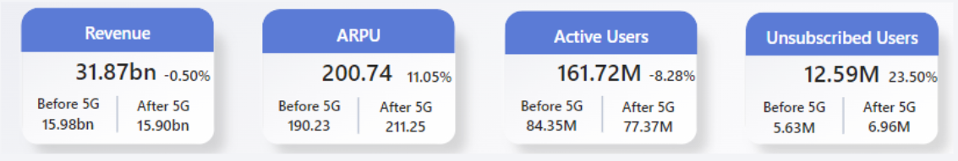
OVERVIEW
After the introduction of 5G, there is a marginal decrease of -0.50% in total revenue, accompanied by a notable 11.05% increase in Average Revenue Per User (ARPU).
Following the 5G implementation, there is an 8.28% decrease in active users and 23.50% increase in unsubscribed users, highlighting a noteworthy surge in user disengagement during the period.

Slide 5
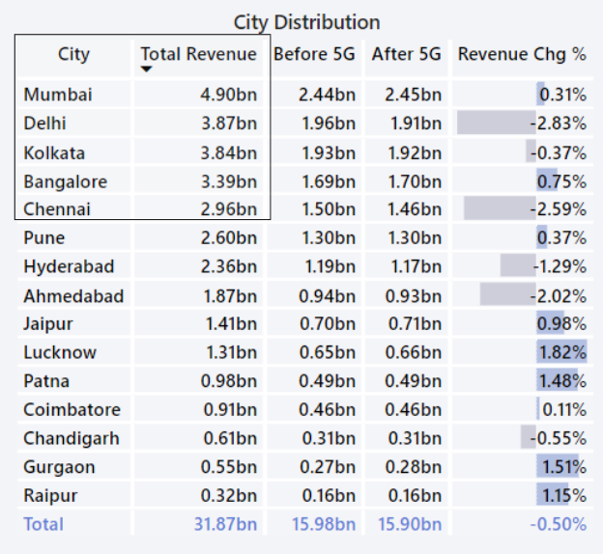
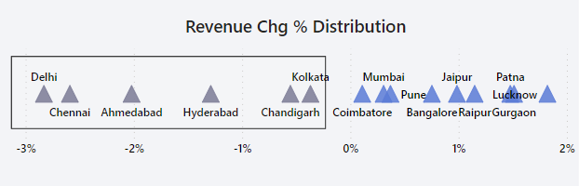
REVENUE ANALYSIS
The top five cities contributing the highest revenue are Mumbai, Delhi, Kolkata, Bangalore, and Chennai.
Following the implementation of 5G technology,
Delhi, Chennai, Ahmedabad, Hyderabad, Chandigarh, and Kolkata experienced a decline in total revenue, with percentage changes ranging from -0.37% to -2.83%.
﻿
Among the top contributors ,
Delhi and Chennai experienced a decline in revenue after 5G implementation, while Mumbai and Bangalore witnessed an increase in revenue.

Slide 6
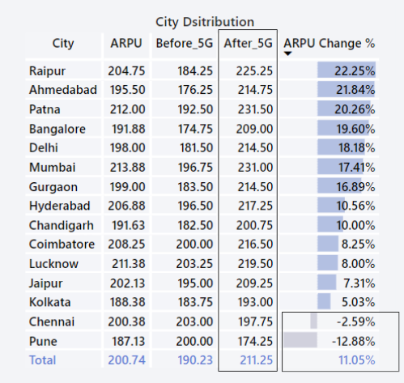
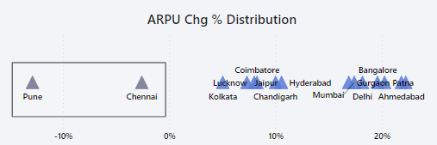
ARPU ANALYSIS
In the ARPU analysis post-5G implementation,
Majority of cities exhibited a positive trend with an increased Average Revenue Per User. Raipur, Ahmedabad, Patna, and Bangalore recorded substantial ARPU growth.
Chennai and Pune deviated from this pattern, indicating a notable decline in ARPU for these two cities.

Slide 7
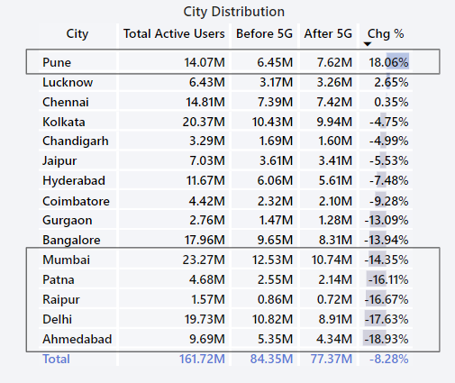
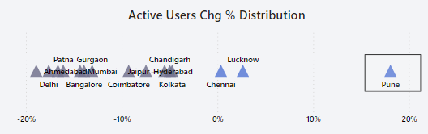
ACTIVE USER ANALYSIS
The key insight from the active user analysis post-5G implementation is a varied impact on user engagement across cities, with Pune experiencing a notable 18.06% increase, while major cities such as Ahmedabad , Delhi, Raipur, Patna, and Mumbai witnessed substantial declines ranging from -14.35% to -18.93%.

Slide 8
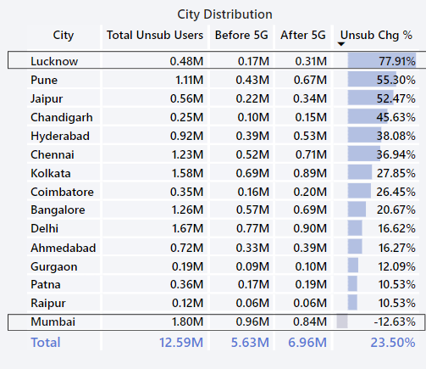
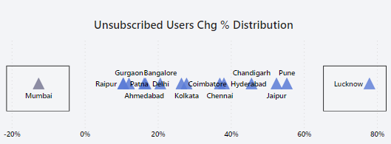
UNSUBSCRIBED USER ANALYSIS
Mumbai stands out as the only city displaying improved performance post-5G, marked by a significant -12.63% decrease in unsubscribed users.
All other cities demonstrate a decline in performance i.e, an increasing numbers of unsubscribed users after 5G.
Lucknow stands out with the highest unsubscribed user rate, indicating the most challenging performance among the cities

Slide 9
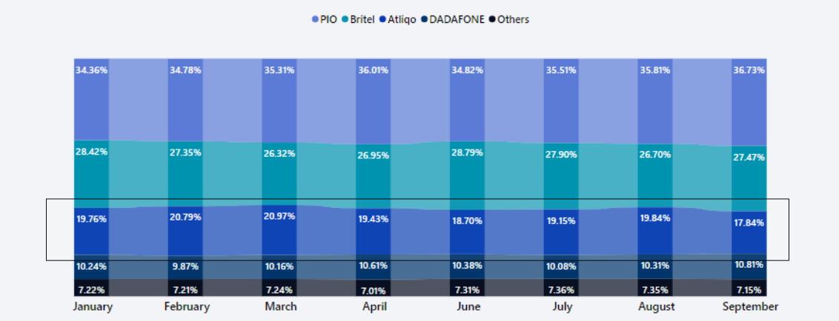
MARKET SHARE ANALYSIS
Before the 5G , Wavecon held a market share of 19.56%, and after the 5G , it slightly decreased to 18.88%.

Slide 10
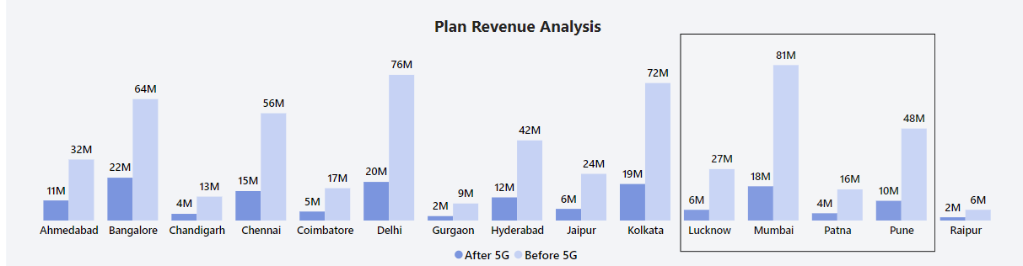
PLAN ANALYSIS
Based on the general trend observed all cities experienced an increase in plan revenue post-5G.
Plan P7, the "25 GB Combo 3G / 4G Data Pack," exhibits the lowest performance post-5G.The total plan revenue for P7 has declined from 582 million to 155.6 million after the 5G.
It's observed that Lucknow, Pune, Mumbai, and Patna have the lowest plan rev. change rates among the cities for Plan P7. These cities experienced a substantial decrease in plan revenue post-5G , indicating a significant negative impact on Plan P7 in terms of revenue generation. The plan rev. change rates for these cities range from approximately -69.6% to -79.2%,

Slide 11
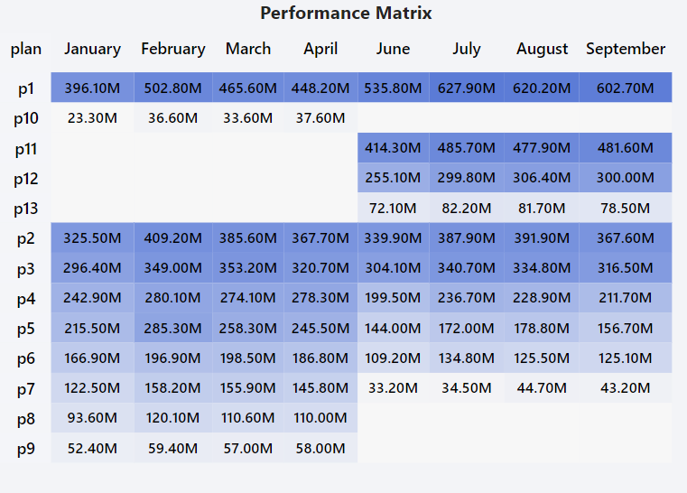
PLAN ANALYSIS
p1 maintains the highest performance both before and after 5G implementation.
p11, p12, and p13 were introduced after 5G. Among them, p13 is not performing well.
p2 and p3 maintain a consistent level of revenue in both pre- and post-5G phases.
p4, p5, p6 initially experienced a decline in post 5G phase. Subsequently improved their performance but later exhibited a decline again for the next two months.
p7 experiences a sharp decline in revenue after 5G.
p8, p9, and p10 were discontinued after the 5G, possibly due to underperformance in the pre-5G phase.

Slide 12
CONCLUSION
Here are some recommendation that can be considered,
Conduct a thorough analysis of Plan P7 to identify issues leading to its revenue decline, and consider revising the plan, by introducing some new features, or providing promotional offers to boost its performance.
Implement targeted strategies in cities that experience declines in active users to enhance customer satisfaction.
Explore opportunities for market expansion in cities where revenue and user engagement have shown positive trends.
Evaluate the performance of newly introduced plans, especially p13, and consider adjustments based on customer feedback.

Slide 13
Thank You
Rejitha Das
Junior Data Analyst

